Slide 1
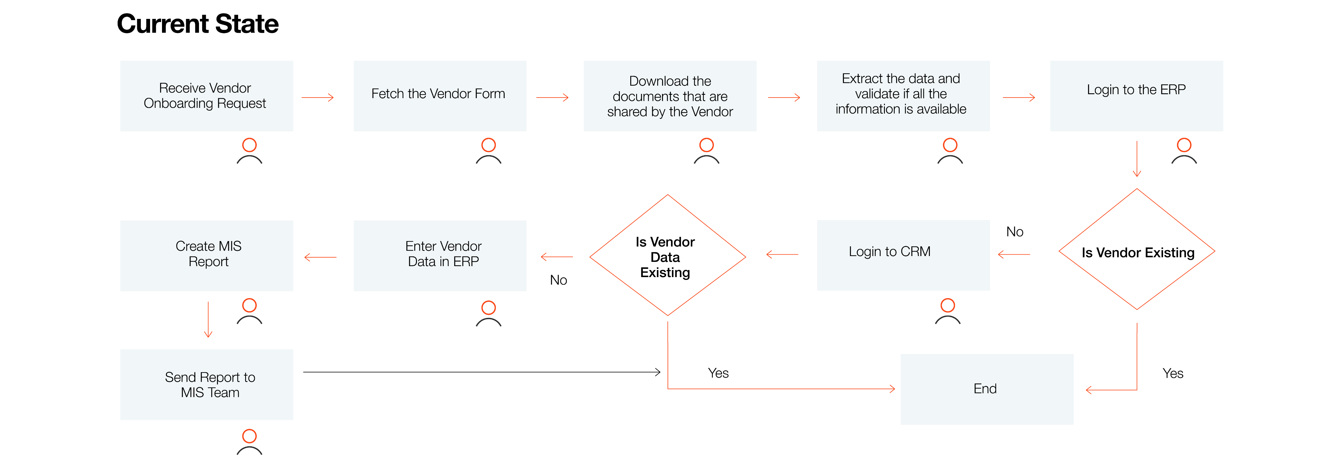
SCM
Vendor Management
Automation of vendor onboarding
Summary: The process involves entering the data for the new vendors based on the documents shared by the vendor to ERP. The information mainly comprises of Vendor registration number, Vendor capabilities details and contacts
Vendor Experience | Team member Experience | Risk/Compliance | Strategic | Process Time | Process Cost
High | High | High | High | High | High
Pain Points | Benefit Details | Average Process Time | Transaction Volume | Potential Gain
The process involves huge amount of manual data entry The delay in onboarding and data entry further delays the operations and delivery to be managed by the vendor | Person dependent process eliminated, allowing time for more strategic initiatives Improved turnaround time for data processing Faster access to the network based on the quick onboarding completion | Takes 20 minutes to onboard each vendor. And the task is distributed among 15 team members to handle the transaction volume. | 225 vendors onboarded Daily | $675K Savings Yearly 1286 Hours per year Saved
Probable tools to be used:
Automation Hub
Core RPA
Document Understanding
Action Center
Task Mining
Process Mining

